Slide 1

Use of marks beyond indicating origin in the Benelux
Dom Perignon, Jiskefet & IKEA
TLI 2024, Maastricht
Dirk Visser
d.j.g.visser@law.leidenuniv.nl

Slide 2

Dom Perignon v Cedric Art
Benelux Court 23 September 2019
Jiskefet v Noblesse Uitgevers
Hoge Raad 27 October 2023
Ikea v Vlaams Belang
pending CJEU case C-298/23.

Slide 3
Article 2.20.2 Benelux Treaty on IP (BTIP)
‘use in the course of trade’
‘for distinguishing goods or services’
A ‘double identity’
B ‘double similarity’ + likelihood of confusion
C similar sign + reputation + unfair advantage or detriment + no ‘due cause’
(identical to current art. 10.2 TM dir. / 9.2 TM reg.)

Slide 4
Article 2.20.2 Benelux Treaty on IP
Sub D
‘use for purposes other than those of distinguishing goods or services’
no ‘due cause
unfair advantage or detriment
(compare art. 10.6 TM dir.)

Slide 5
Article 2.23.1.b&c Benelux Treaty on IP
A TM trademark shall not entitle the proprietor to prohibit a third party from using, in the course of trade: […]
b. signs or indications […] which concern […] characteristics of goods or services;
c. the trademark for the purpose of identifying or referring to goods or services as those of the proprietor of that trademark
provided that such use is made in accordance with honest practices in industrial or commercial matters.
(identical to art. 14.1.b&c TM dir. / 14.1.b&c TM reg. )

Slide 6
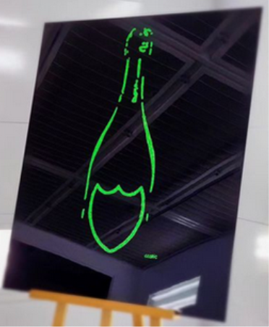
Dom Perignon / Cedric Art

Slide 7
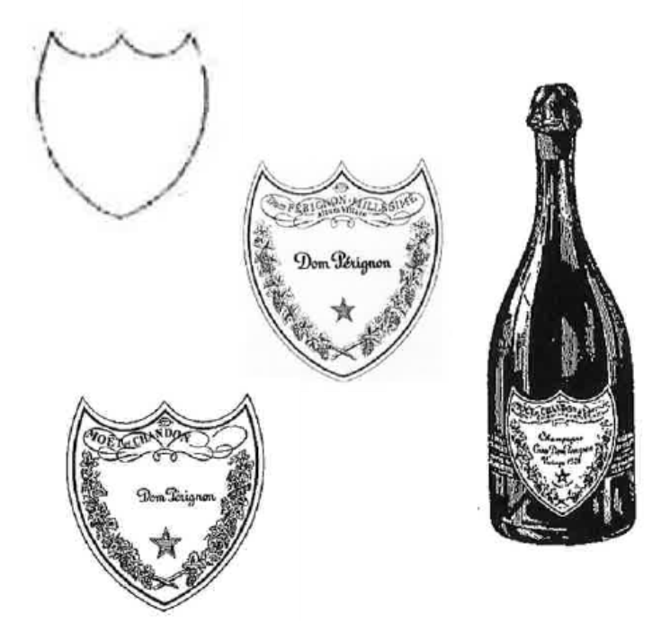
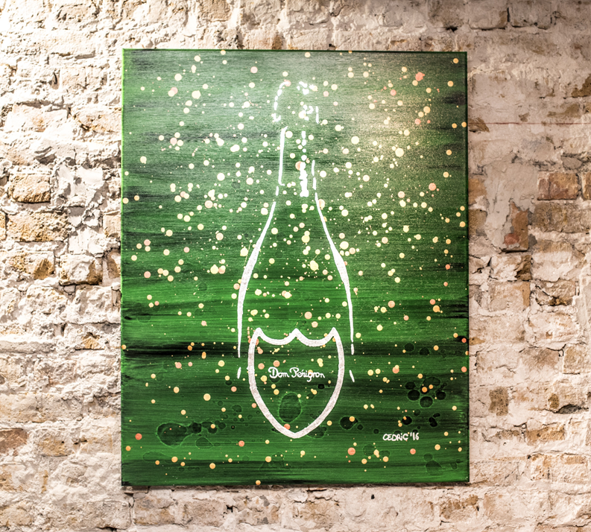
Dom Perignon / Cedric Art
Moët Hennessy Champagne Services (MHCS) v Cedric Art

Slide 8
Questions of the Brussels Company Court
Freedom of information/ artistic freedom > ‘due cause’?
  Art. 10 ECHR , art. 11 EU Charter
What are relevant criteria?
  degree of commercal character or purpose
  general interest, public debate
  degree reputation
  scale of the use: intensity, territory, duration. In relation tot the message
  additional circumstances, name of the work (‘damn perignon’). detriment , image of the TM (‘advertising function’)
  own orignal contribution, avoidance of confusion or association (‘origin function’)

Slide 9
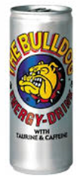
Answer by the Benelux Court
Reference is made to CJEU Leidse Plein Beheer / Red Bull
“the concept of ‘due cause’ may not only include objectively overriding reasons but may also relate to the subjective interests of a third party using a sign which is identical or similar to the mark with a reputation”.
“to strike a balance between the interests in question by taking account, […] the interests of the third party using that sign”.
point 45-46

Slide 10
Answer by the Benelux Court
Reference is made to recital 27 TM dir.
“Use of a trade mark by third parties for the purpose of artistic expression should be considered as being fair as long as it is at the same time in accordance with honest practices in industrial and commercial matters. Furthermore, this Directive should be applied in a way that ensures full respect for fundamental rights and freedoms, and in particular the freedom of expression”.

Slide 11
Answer by the Benelux Court
Article 2.20(2)(d) BTIP should be interpreted as meaning that artistic freedom constitutes ‘due cause’ within the meaning of this provision
‘if the artistic expression is the original result of a creative formative process that is not aimed at damaging the trademark or its proprietor’.

Slide 12
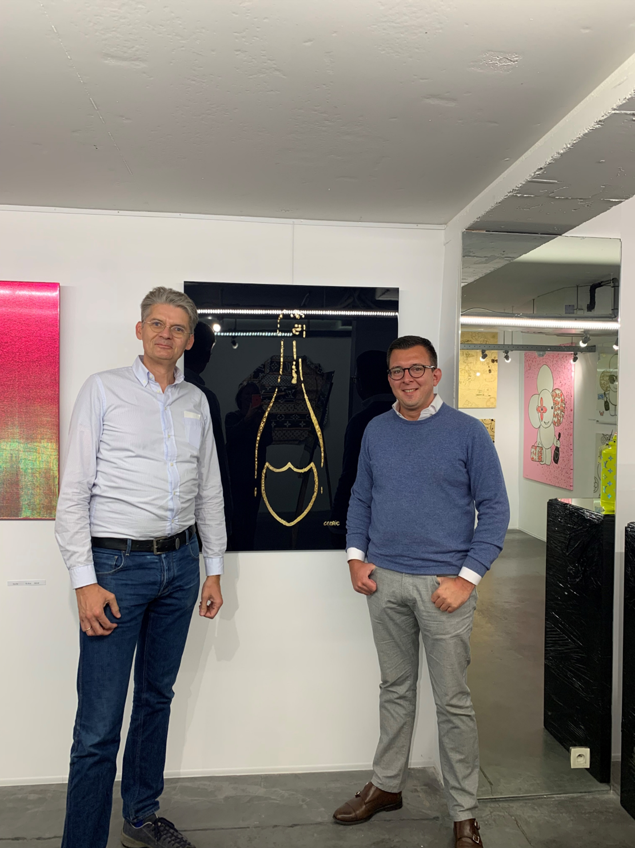
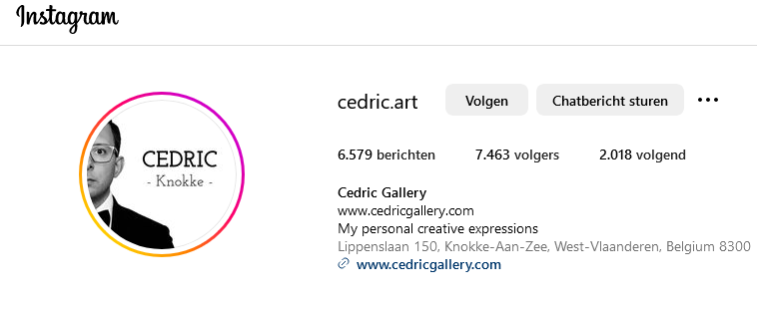
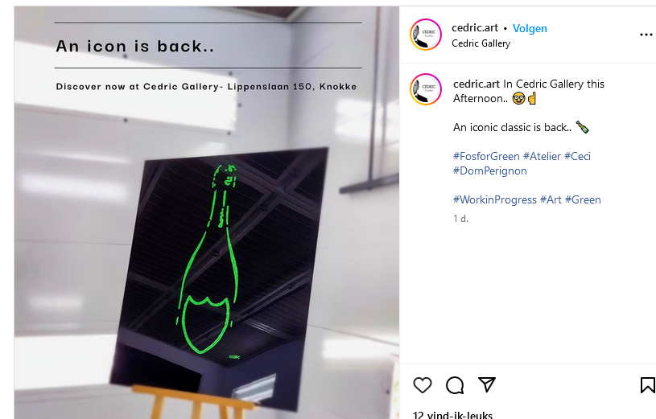

Slide 13

Jiskefet v Noblesse Uitgevers

Slide 14
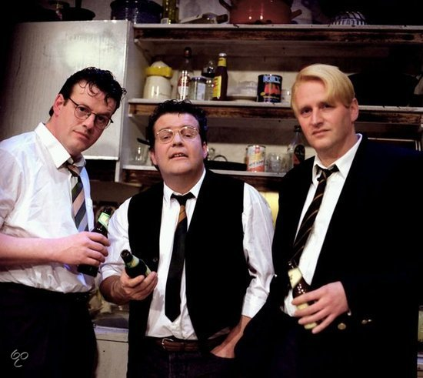


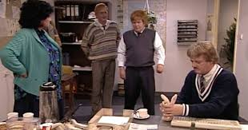
Jiskefet v Noblesse Uitgevers
JISKEFET BX wordmark in class 16 (books)
Caberet trio, Dutch TV Series 1990-2010

Slide 15

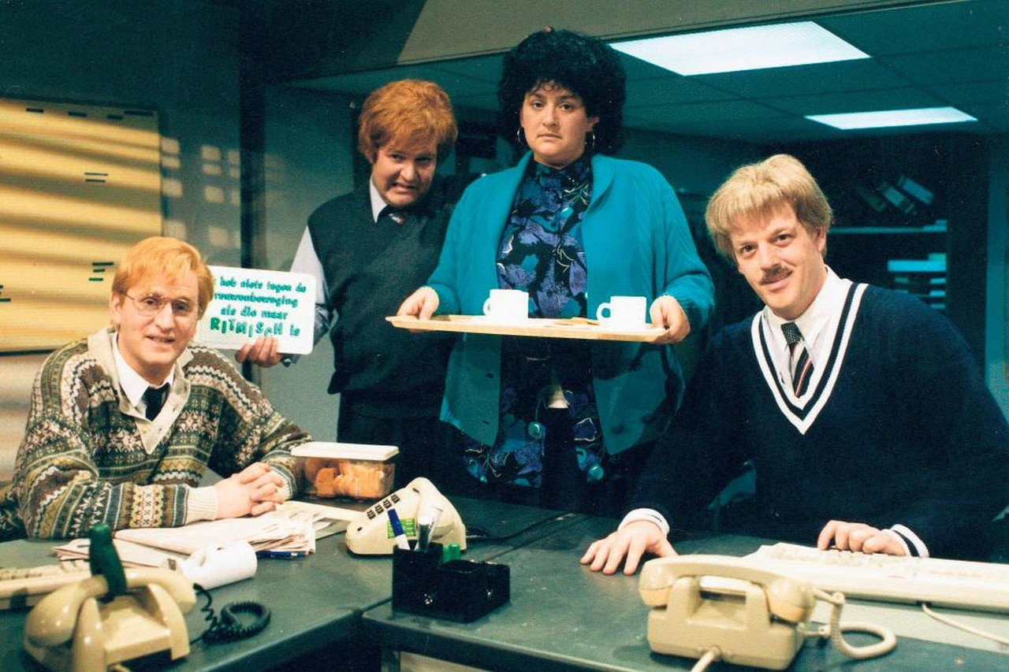

Slide 16
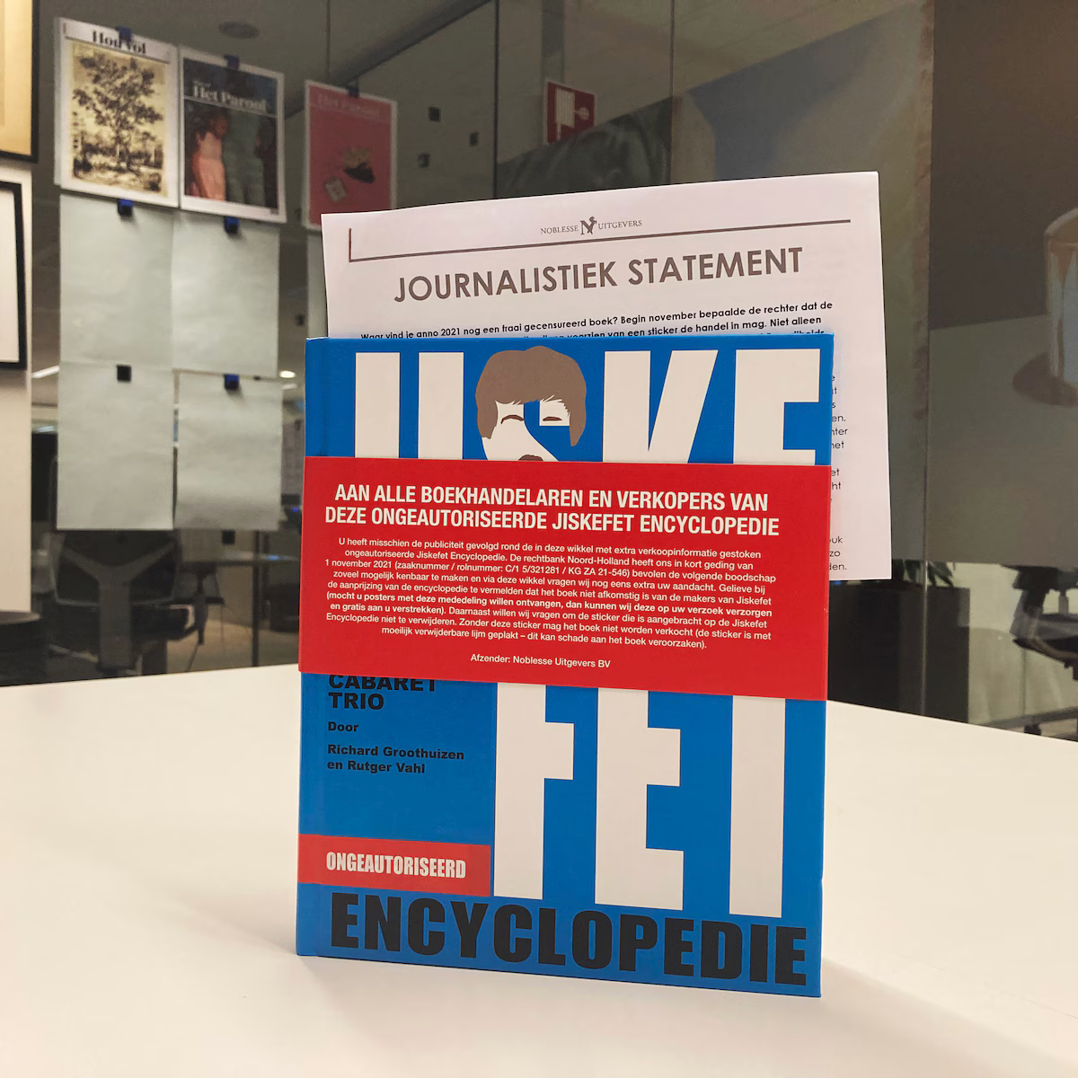
Amsterdam District Court
Noblesse is ordered to take measures to ensure that the book is only sold bearing the statement:
‘Jiskefet is a trademark of Jiskefet B.V. - This book does not originate from Jiskefet B.V. or the creators of Jiskefet.’

Slide 17
Amsterdam Court of Appeal
The title of a book forms part of the goods themselves and is not a distinguishing mark by which a publisher wishes to distinguish those goods as originating from it.
This means that the use by Noblesse does not constitute infringement within the meaning of Article 2.20(2)(a), (b) or (c) of the BTIP.
There can therefore only be trademark infringement by Noblesse if its use of the sign is covered by the aforementioned provision under d.
In the court's opinion, this is not the case.

Slide 18
Amsterdam Court of Appeal
The book contains more or less matter-of-fact descriptions of the well-known television programme ‘Jiskefet’ as a phenomenon in (very recent) Dutch cultural history, brought together in an encyclopaedic handbook in which facts worth knowing about characters, episodes and other parts of the programme ‘Jiskefet’ are made accessible via an alphabetical arrangement.
The parties agree that Noblesse is free to publish a book with this content.
For such a book, the title ‘Jiskefet Encyclopaedia’ constitutes a very obvious indication of its content and therefore, also in view of the fundamental right of freedom of information, Noblesse has ‘due cause’ for using that title.

Slide 19
Amsterdam Court of Appeal
Given the inherently permissible nature and descriptive content of the book, the advantage enjoyed by Noblesse cannot be considered unfair. Nor is detriment to the distinctive character of the trademark or its reputation at issue in this case.
It follows from the above that, in the preliminary opinion of the court, Noblesse has not infringed the rights, associated with the trademark JISKEFET.

Slide 20
Hoge Raad (Dutch Supreme Court)
Should the court have considered whether the use was made
“in accordance with honest practices in industrial or commercial matters” ?
No. If there is ‘due cause’ (and no detriment or unfair advantage), there is no need to check the applicability of the conditions for descriptive or referential use.

Slide 21
IKEA / Vlaams Belang

Slide 22


IKEA / Vlaams Belang Case C-298/23
Reference by the Brussels company court
‘IMMIGRATION REALLY CAN BE DIFFERENT’

Slide 23


CJEU september 2014 Deckmyn v Vandersteen

Slide 24
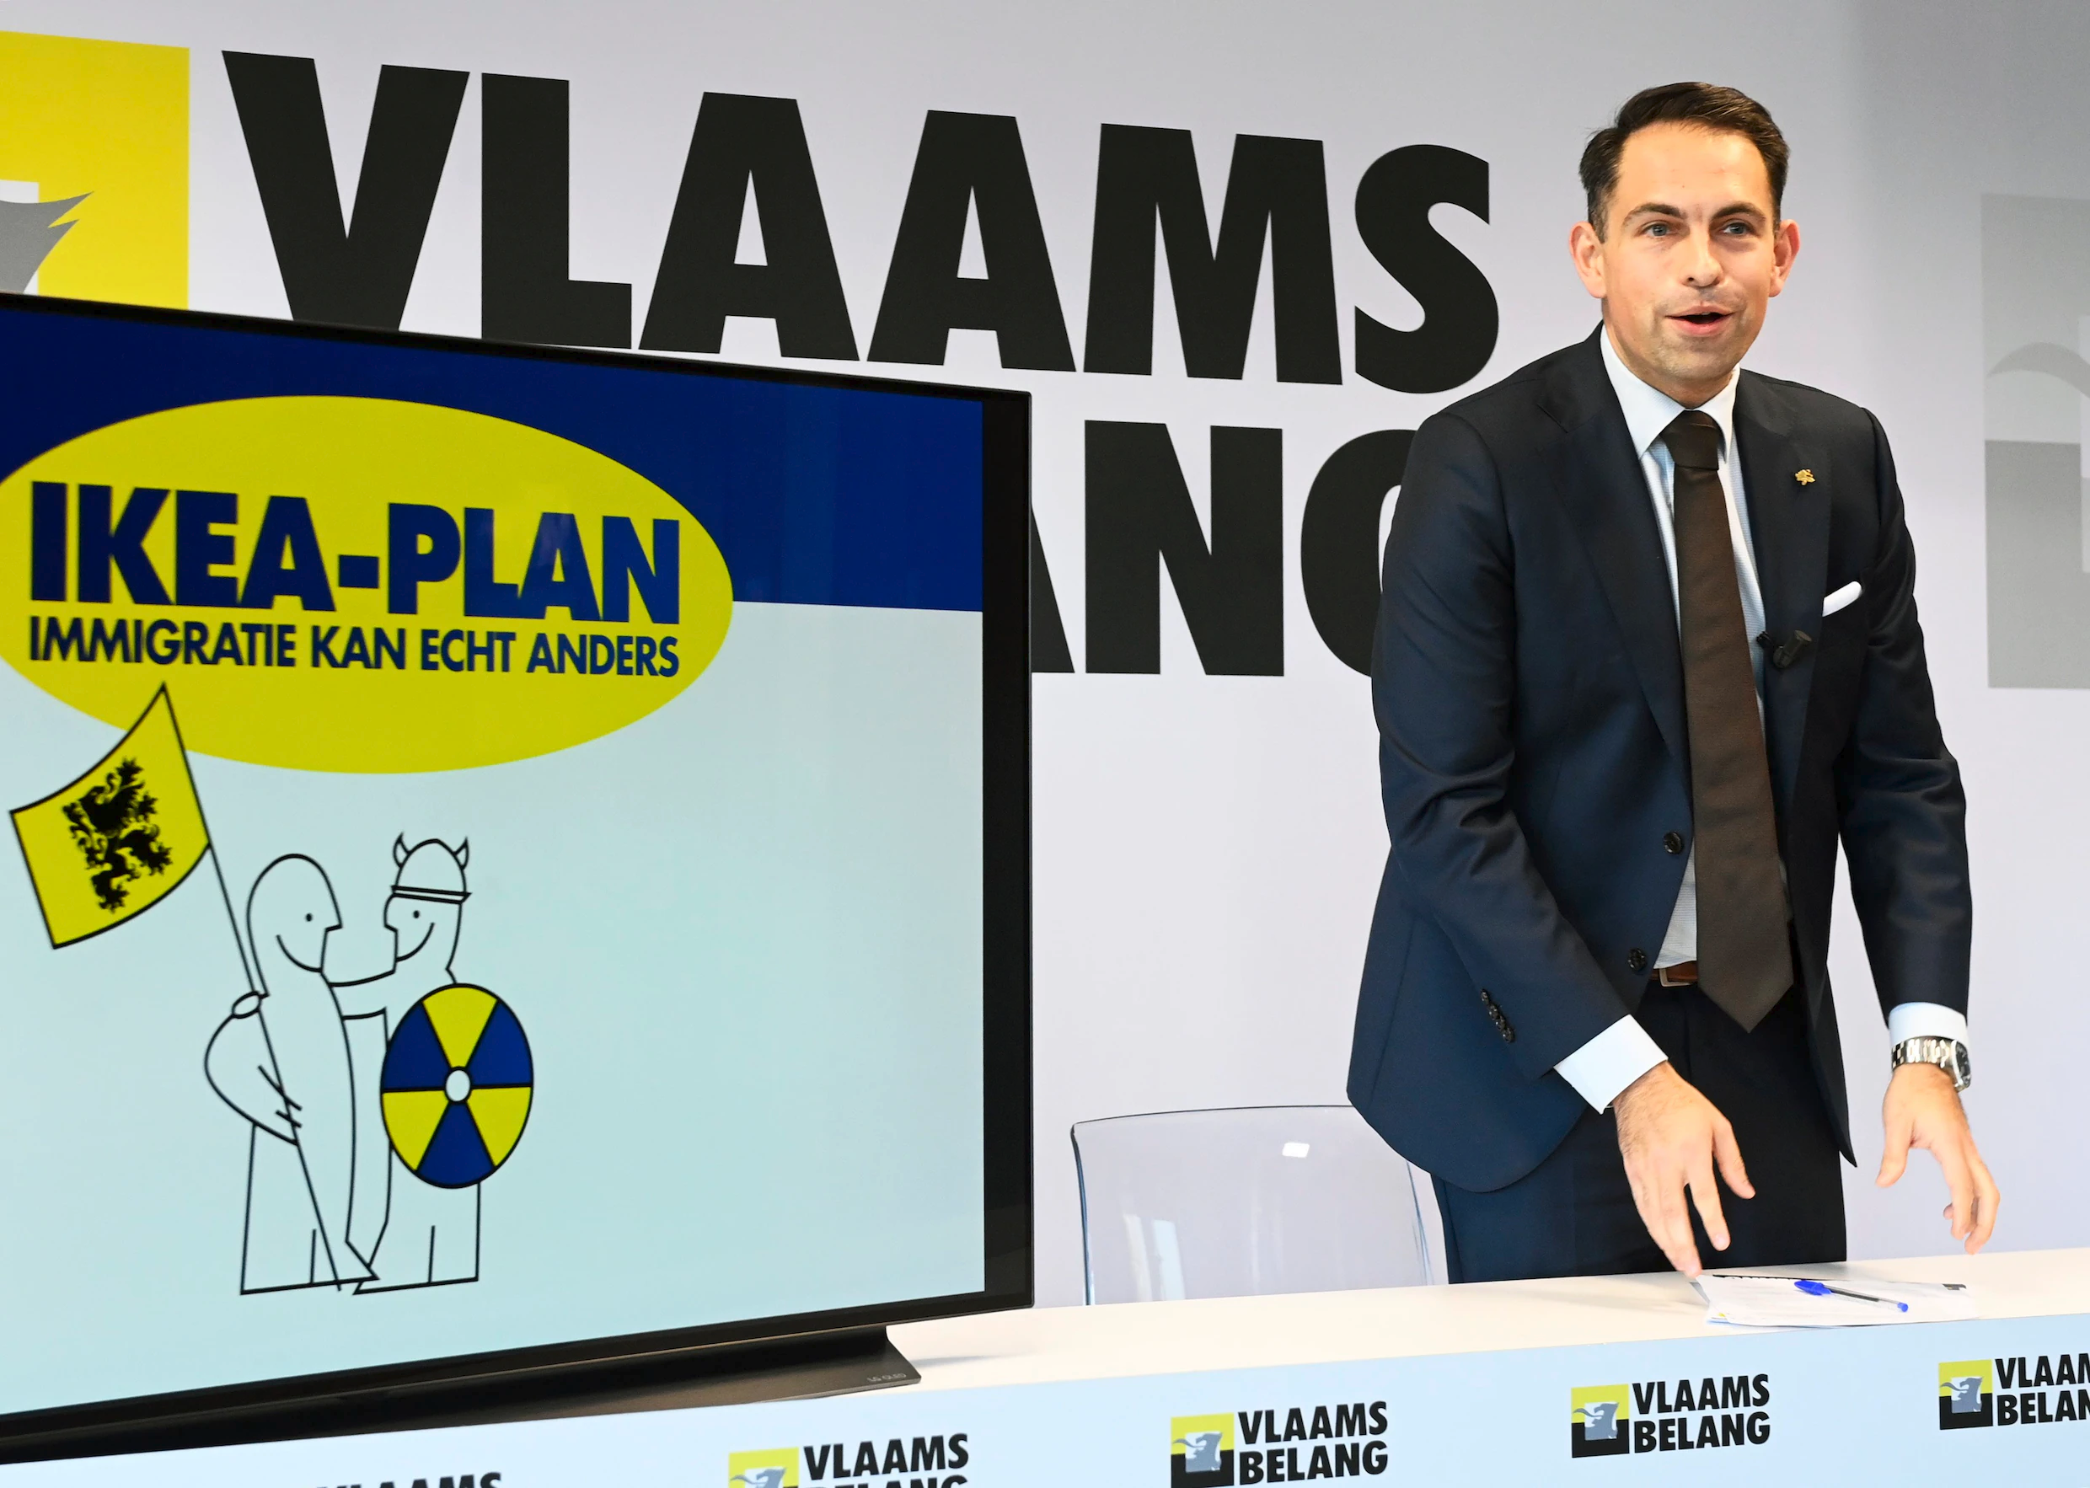


Slide 25
Questions by the Brussels company court
Can freedom of expression, including the freedom to express political opinions and political parody, as guaranteed by Article 10 of the European Convention for the Protection of Human Rights and Fundamental Freedoms and Article 11 of the Charter of Fundamental Rights of the European Union,
constitute ‘due cause’ for using a sign identical or similar to a well-known trademark within the meaning of Article 9(2)(c) TM reg., Article 10(2)(c) and Article 10(6) of TM dir.?
? Robelco-case

Slide 26
Questions by the Brussels company court
Relevant criteria?
the extent to which the expression has a commercial character or purpose;
the extent to which competitive motives are at play between parties;
the extent to which the expression has a public interest, is socially relevant or opens a debate;
the relationship between the above criteria;
the degree of reputation of the trademark invoked;
the extent of the infringing use, its intensity and systematic nature and the extent of its distribution, by territory, time and volume, also taking into account the extent to which this is proportionate to the message that the expression is intended to convey;
the extent to which the expression, and circumstances accompanying that expression, such as the name of the expression and its promotion

Slide 27
Procedural peculiarity
IKEA appealed against the decision to refer the case to the CJEU
Court of Appeal Brussels to decide the admissability of this appeal in september.
CJEU does not have to wait for the outcome of this appeal.
  But seems to do so.
  If there is no longer a pending national case the CJEU will not answer the questions.

Slide 28
‘use in the course of trade’?
‘use as a TM’? (for distinguishing goods or services)
confusion? unfair advantage? detriment? (intent to harm?)
‘due cause’? (free speech / artistic freedom)
‘referential use’?
‘in accordance with honest trade practices’?

