Slide 1
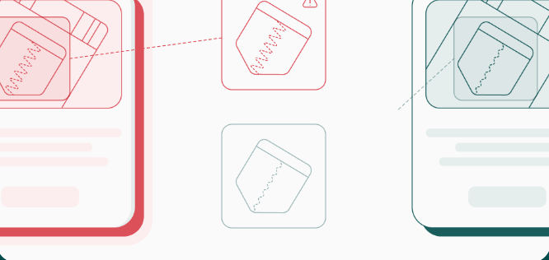
Panoptic Brand Protection? Machine Learning and Online Marketplaces
Prof. Dev Gangjee
University of Oxford
© Corsearch

Slide 2
Outline
Counterfeits continue to be sold on online marketplaces
Algorithmic filters (AI) developed in response to scan listings
Early versions of AI were rules-based, explainable
Current versions on larger platforms (Alibaba, Amazon, eBay) are powered by machine learning (ML)
In the EU/UK, no legal obligation to adopt comprehensive filtering technology
However voluntarily adopted by platforms; increasingly “privatised injunctions”
The new EU Digital Services Act (DSA) introduces “due process” for content moderation
Greater transparency and accountability?
Or unprepared for ML?
Still tied to Notice and Takedown Model?

Slide 3
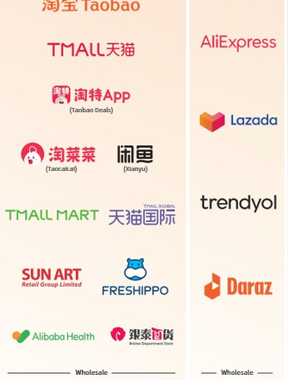
Scale requires Automated Filtering
In 2023 (Q1), eBay had 133 million global buyers; 1.8 billion live items on the platform, across 190 markets globally.
China’s has largest e-commerce industry in the world; Alibaba’s revenue was US$142.3 billion in 2022; + other major players like JD
124 million annual active consumers on Taobao, Tmall (2023)
AI allows real-time detection and automated actions/delisting
However the concern is the net may be cast too wide.
Genuine products sold outside authorised distribution channels?
Legitimate parallel imports?
Second-hand, repaired or refurbished products?
Legitimate competitive substitutes? (Design or patent expired, can copy).

Slide 4
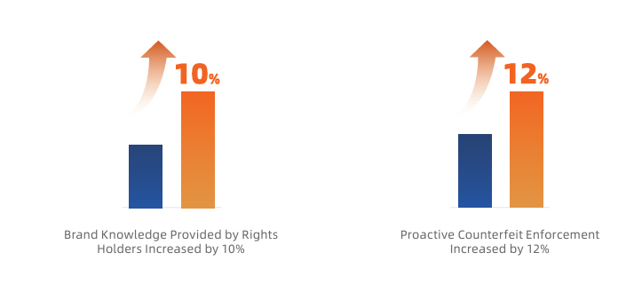
The Turn to ML Models
Amazon Brand Protection Report (2023)
“Through our continued investment in advanced machine learning techniques, we have improved our proactive controls, automating and scaling our intellectual property protection and counterfeit detection systems. These systems operate continuously throughout every step of the process—from the moment someone tries to register a new selling account, create a listing, and update a product listing. This includes incorporating the feedback we get from customers, brands, and others” (April 2023)
Alibaba Group Annual Report on IP Protection (2022)
“Powered by algorithms and machine learning, Alibaba is better than ever at detecting infringements from the perspective of rights holders. Alibaba also allows rights holders to view infringement governance and results using online visual tools such as dashboards… Alibaba is [thus] able to link online monitoring, with algorithmic governance, and even to offline enforcement efforts, creating closed-loop IP protection capacity.”

Slide 5
What’s Different?
Previous filtering was rules-based, explainable (eBay litigation in early 2000s)
Symbolic expert systems E.g. search for defined keywords
ML only returns a probabilistic score
Lacks explainability
Blind spots

Slide 6
Range of Data Points for Supervised ML models
Listings/Offers
Product images (incl. logos, TMs)
Advanced image recognition
Textual product description
High quantity of goods
(Suspiciously low) price
Time stamp
Geolocation
Consumer reviews (NLP)
Seller details/transaction history
Sales history (previous flags?)
Seller identity
Inadequacy of vetting
Location
Frequency and timing of sales
Payment methods
Shipping details

Slide 7
Training on Labelled Data
Ground truths for classification algorithm (counterfeit or legitimate)?
Labelling? Draw on past human decisions
Platform content moderators
Verified NTDS + evidence filed by brand owners
Verified complaints from users (customers/buyers)

Slide 8
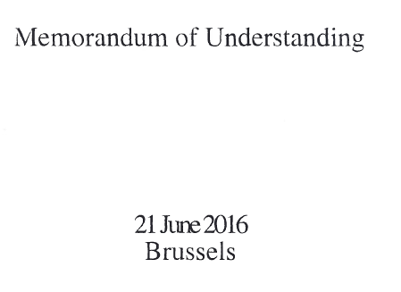
Legal Position?
No existing obligations in EU/UK legislation to install real-time filtering across the whole platform
Platforms cannot be required by judicial injunctions to install such general filtering technology
Art 15 e-Commerce Directive (no general monitoring)
Art 6 Digital Services Act (no general monitoring)
Can only be required to prevent similar infringements in the future: same TM + similar products + same identified seller
However leading marketplaces have voluntarily adopted wide-ranging automated filtering systems
Brand owners allowed to directly train algorithms; “delist with one click”
Different implementation approaches: tests for what is “infringing”
Different procedural safeguards

Slide 9
Greater accountability for delisting decisions?
Platforms control the behaviours of their users through privately developed norms.
Given effect contractually through Terms of Services or Terms of Use, which must be agreed to when accessing online marketplaces.
Policies are either developed unilaterally by platforms, or else in consultation with certain select groups (big brand owners)
The shift from
Public ➔ private law enforcement; consolidation of different stages
Automated/algorithmic process (reasons for decisions?)
Large scale effects; affects multiple parties

Slide 10
New DSA Requirements
Key requirements: transparency & accountability
Require “sufficiently precise and adequately substantiated notices” of infringement (Art 16(2))
NTD feeds into ML training
Give reasons for blocking to seller
Indicate to seller when their listing has been blocked by ACR algorithm decision
Give sellers redress options (challenge delisting)
Human review by marketplace or ADR
Transparency and reporting obligations

Slide 11
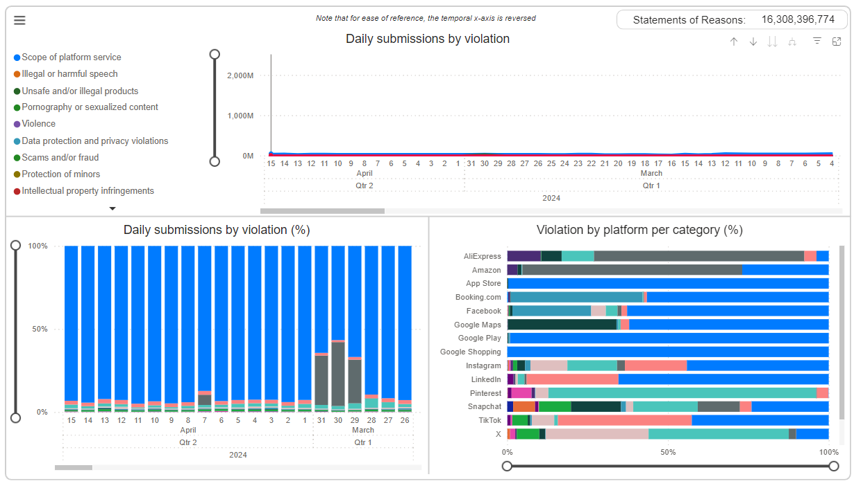
Dashboard and Datasets

Slide 12
Remaining Issues…
DSA requires greater accountability (reasons for content moderation)
However seems to presume a “notice and takedown” system with humans giving reasons
What happens where delisting is based on AI decision?
AI operates via machine learning (pattern recognition); black box problem?
Will this reverse burden of proof?
ML indicates a statistical probability that product is counterfeit
Seller must now prove their product is genuine?
How heavy is this burden of proof? What must a seller show?

Slide 13
Thank You!
Questions welcomed: dev.gangjee@law.ox.ac.uk

