Slide 1
The many faces of bad intentions and their limitations from refiling to revival
6 and 7 June 2024
Trademark Law Institute Symposium 2024
Tobias cohen Jehoram – Erasmus university rotterdam

Slide 2
Content
Bad faith
Filing of 'not-used' trademarks
Filing of 'historic' trademarks

Slide 3
WHAT IS BAD FAITH?
Bad faith
- Not defined in EU/harmonized legislation
- All room for the ECJ
- and the General Court, on factual appreciations of 'bad intent'

Slide 4
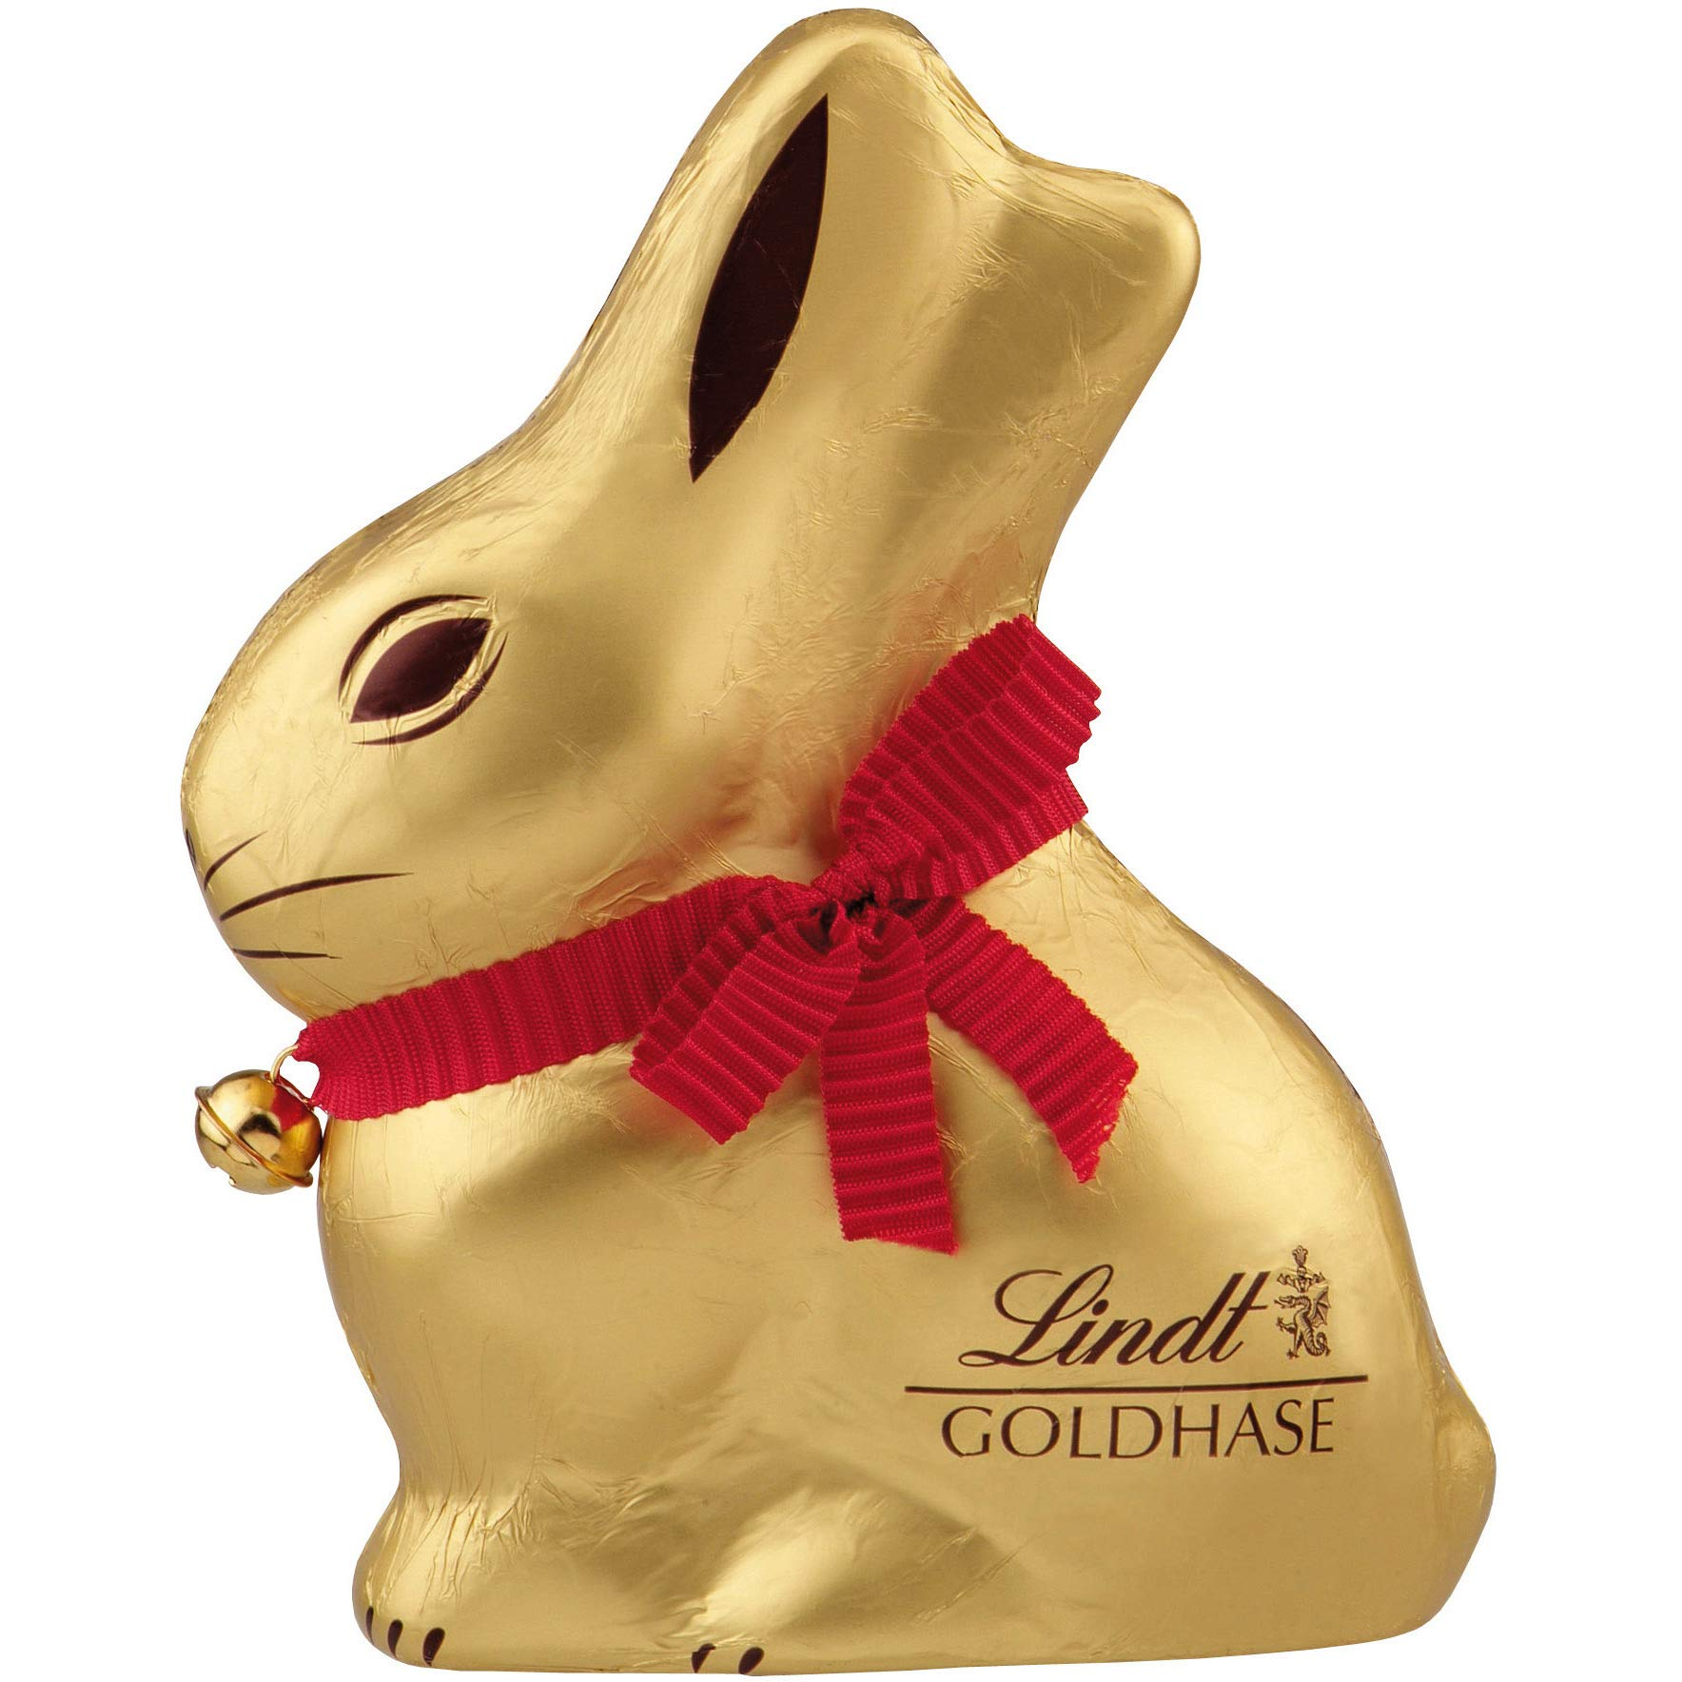
LINDT CASE
ECJ 11 June 2009 C-529/07
Facts
Since the 1930s, Hauswirth had been selling chocolate bunnies in both Germany and Austria.
Lindt started producing chocolate bunnies in the 1950s, first marketing in Austria in 1994.
Lindt registered the shape of the bunny as an EU trademark in 2000.
Hauswirth claimed that this registration was made in bad faith.
Judgment
Par 53: "In order to determine whether the applicant is acting in bad faith (…) the national court must take into consideration all the relevant factors specific to the particular case which pertained at the time of filing the application for registration of the sign as a Community trademark, in particular:
the fact that the applicant knows or must know that a third party is using, in at least one Member State, an identical or similar sign for an identical or similar product capable of being confused with the sign for which registration is sought;
the applicant’s intention to prevent that third party from continuing to use such a sign; and
the degree of legal protection enjoyed by the third party’s sign and by the sign for which registration is sought."

Slide 5
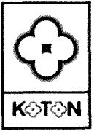
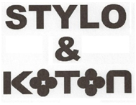
KOTON V EUIPO CASE
ECJ 12 September 2019 C-104/18 P
A trademark is registered in bad faith when (par 46) "it is apparent from relevant and consistent indicia that the proprietor of an EU trade mark has filed the application for registration of that mark not with the aim of engaging fairly in competition but with the intention of undermining, in a manner inconsistent with honest practices, the interests of third parties, or with the intention of obtaining, without even targeting a specific third party, an exclusive right for purposes other than those falling within the functions of a trade mark"
Indicating origin, guaranteeing the quality, communication, investment or advertising functions.
There is no requirement that an earlier trademark is registered for the same or similar goods or services.
The commercial logic underlying the filing of the application for registration and the chronology of events leading to that filing can be relevant factors to consider when establishing bad faith (par. 62).
Earlier marks belonging to Koton (Classes 18, 25 and 35)
EUTM application by Mr. Nadal (Classes 25, 35 and 39)

Slide 6
Sky v Skykick CASE
ECJ 29 January 2020 C-371/18
Relevant facts
Sky brought actions against SkyKick for infringement of its trademarks across a range of goods and services, while SkyKick challenged the validity of the trademarks
Sky registered trademarks for a wide variety of goods and services, including those that clearly fell outside of the scope of the commercial activities that Sky was conducting at the time of the trademark application.
Sky also registered for goods and services with very broad terms such as 'computer software' or 'telecommunication services'.
Preliminary questions
Can a mark be declared wholly or partially invalid on the ground that some or all of the terms in the specification of goods and services are lacking in sufficient clarity and precision?
Can it constitute bad faith simply to apply to register a trademark without any intention to use it in relation to the specified goods or services?
Is the 'intent to use' requirement under UK law compatible with EU law?

Slide 7
Sky v Skykick CASE
ECJ 29 January 2020 C-371/18
Answers to preliminary questions
When there are grounds for revocation of rights in respect of only some of the goods or services for which the trademark is registered, revocation is to cover only those goods or services (par. 69). However, trademarks cannot be declared wholly of partially invalid solely on the ground that terms used to designate the goods and services lack clarity and precision (par. 71).
To establish that an unused trademark was registered in bad faith, it must be established from objective, relevant and consistent indicia that there existed a
dishonest intention of undermining the interests of third parties; or
an intention to obtain an exclusive right for purposes falling outside the functions of the trademark.
A trademark applicant's lack of current economic activity related to the applied for goods or services does not automatically imply bad faith (pars. 75-77).
The UK provision is in principle compatible with EU trademark law, but only as a procedural requirement; intent to use not required under EU law (par. 87).

Slide 8
'not-used' trademarks before the gc

Slide 9
PELIKAN CASE
GC 13 December 2012 T‑136/11
Facts
On 22 August 2003, Pelikan filed an application for Community trademark for figurative sign 'Pelikan' in classes 35 (advertising, administration) and 39 (transport, organizing travel).
Pelikan already held a CTM registered on 1 April 1996 for the figurative mark 'Pelikan' in many classes.
On 1 October 2008, Pelicantravel.com filed an application for revocation of the earlier CTM in Classes 35 and 39. It also filed an application for invalidation of the contested CTM, claiming that it had been filed in bad faith: only a re-filing of the earlier CTM to avoid the loss of rights.
In 2010, the earlier CTM was revoked for non-use in Classes 35 and 39.
Judgment
A repeat application for a revoked trademark to avoid the loss of rights due to non-use can amount to bad faith (par. 27), but this is only one of the relevant factors to assess (par. 34).
Even if the services registered are not being offered under the CTM at the time of the application, this does not automatically mean that the application has been made in bad faith. Instead, the applicant of the invalidation has to provide evidence that the application is "bogus" and "makes no commercial sense" (par. 46).
There is a presumption that a sign has been filed in good faith until proof to the contary is adduced (par. 57).
CTM registration (Classes 35 and 39)
Earlier CTM belonging to Pelikan (Classes 1, 3, 8, 11, 14, 18, 20, 21, 24, 28, 35, 37, 39, 41 and 42)

Slide 10
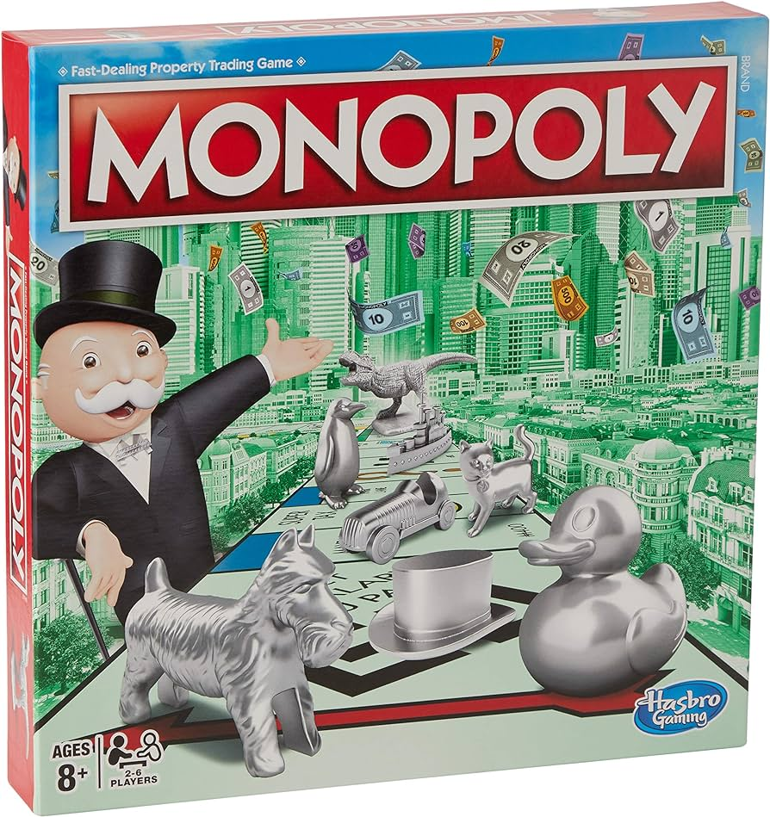
Monopoly case
GC 21 April 2021 T-663/19
Facts
On 30 April 2010, Hasbro Inc. filed for an EU wordmark 'MONOPOLY'.
At time of application, Hasbro already held three trademarks with partly identical goods and services.
A third party sought to invalidate the contested mark on the basis that Hasbro had applied for it in bad faith, since it was identical to two of Hasbro's earlier trademarks for the same word in the same classes for goods and services. The applicant argued that Hasbro only filed the contested mark to avoid the proof of use of the earlier marks.
Hasbro admitted in the proceedings that it had filed the application to avoid the proof of use but argued that this was a widespread strategy within the industry, commonly known as 'evergreening'.
Judgment
The three factors set out in the Lindt case are only examples of factors to assess when deciding if an applicant acted in bad faith when filing the application (par. 36).
Re-filings of same trademark are not prohibited; such filing alone cannot establish bad faith (par 70)
Here bad faith by re-filing, by artificially creating a situation in which no genuine use had to be proven, circumventing the use requirement of art. 18 EUTMR (pars. 71-72).
The argument that it is common strategy must be rejected and cannot be relied upon to cast doubt on the assessment of bad faith (par. 94).
Notes:
Par 41: "The concept of bad faith relates to a subjective motivation on the part of the trademark applicant, namely a dishonest intention or other sinister motive. It involves conduct which departs from accepted standards of ethical behaviour or honest commercial and business practices."

Slide 11
Discussion
On IPKat following T-663/19 (Monopoly)
Subject of the debate
In a post published on 29 April 2021, the IPKat editor wrote:
"The GC is telling us that any repeat filing for identical goods will prima facie constitute bad faith."
Reasons to doubt this position
Re-filing per se is a legitimate practice, which is highlighted by the GC throughout the judgment (pars. 43, 57 & 70).
When establishing bad faith, it is only the trademark holder's intention that is critical, not whether a trademark has been re-filed per se (par. 83).
All of the specific circumstances of the case have to be taken into account when establishing bad faith (par. 71). In this case those circumstances also included the filing of oppositions based on the trademark at stake (par. 59) and the fact that the earlier marks had not been surrendered (par. 60).

Slide 12
Discussion
On IPKat following T-663/19 (Monopoly)
What to derive from the judgment instead
Re-filing as such is considered a legitimate business practice.
Re-filing as such is not sufficient to find bad faith; only the dishonest intent behind a refiling could make the later filing a bad faith filing.
Assessing whether a trademark was filed in bad faith is case specific and depends on various factors.
Reaction from the IPKat editor
Any re-filing is an indication of bad faith unless specific reasons justify that.
There is a difference between re-filings not being "prohibited" and these being "legitimate".
The GC has made very clear that repeat filings seeking to circumvent the rule relating to proof of use are illegitimate (pars. 70 & 72).
Re-filing without the use of the earlier mark shifts the burden of proof on the proprietor to show that the re-filing was legitimate, which is in accordance with the purpose of the proof of use rule.

Slide 13
Historic trademARKS

Slide 14
HISTORIC TRADEMARKS
What are they?
Trademarks that have been popular in the past, but have been abandoned by their original owner ("zombie trademarks").
These trademarks still enjoy remaining consumer recognition and possibly goodwill.
In some cases, such marks get registered again by parties that are not affiliated with the owner of the original registration.
The goal: to gain commercial success from the residual reputation of the original trademark.
Is the filing of a historic trademark an example of bad faith?
The issue has been touched upon in the following cases:
SIMCA case (GC 8 May 2014 T-327/12)
Nehera case (GC 6 July 2022 T-250/21)

Slide 15
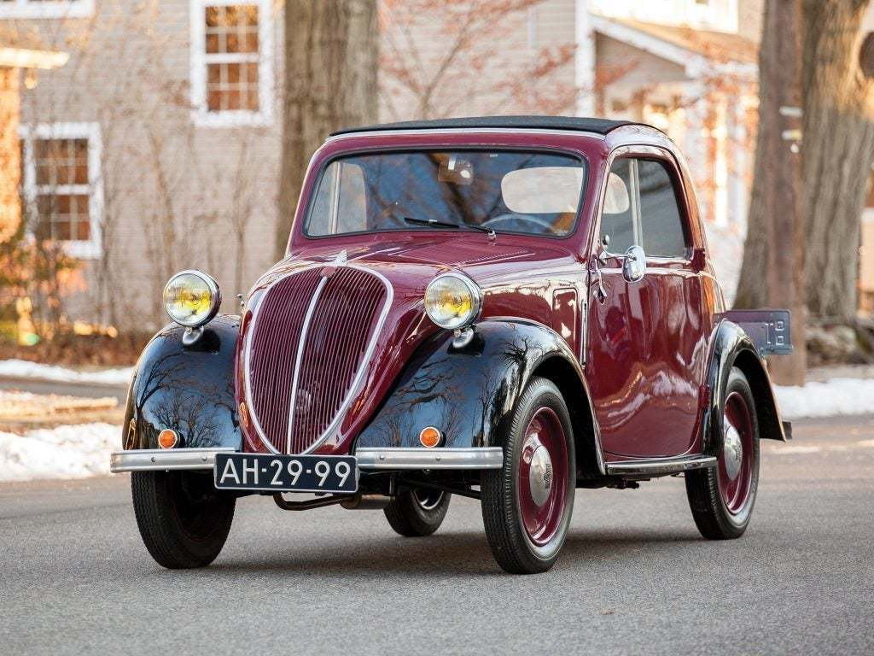
Simca case
GC 8 May 2014 T-327/12
Facts
'SIMCA' was a well-known brand in the car industry, created in 1934 in France.
Up until the late 1970s, the predecessor of GIE PSA Peugeot Citroën used 'SIMCA' as a trademark for cars, broadly used. After this period, the mark was left unused.
On 5 December 2007, registration was sought for the word mark 'Simca'
Judgment
Bad faith should be determined by an overall assessment of relevant facts. The three factors set out in the Lindt judgment should particularly be assessed (par. 36).
Even though the earlier trademark had not been used during the preceding decades in the present case, it still had a certain degree of surviving reputation among the public interested in cars. The proprietor was aware of this (par. 49).
There was bad faith when registration was sought, as it could be inferred from the circumstances of the case there was a clear and evident intention to:
Take advantage of the residual reputation of the sign SIMCA (par. 56);
Create an association with the earlier trademark (par. 63);
Compete with those earlier marks if they were re-used in the future (par. 63).
Notes:
The BoA was entitled to infer from the particular circumstances of the present case that the real purpose of the applicant was to ‘free-ride’ on the reputation of the invalidity applicant’s registered marks and to take advantage of that reputation (par. 56

Slide 16
NEHERA case
GC 6 July 2022 T‑250/21
Facts
On 6 May 2013, trademark registration was sought for the figurative sign 'Nehera' by a Slovak resident. The trademark was registered on 31 October 2014.
On 17 June 2019, an application for a declaration of invalidity against that mark was filed by the grandchildren of Mr Jan Nehera. They stated that, in the 1930s, their grandfather had established a business marketing clothing and accessories in Czechoslovakia for which he had filed and used a national mark identical to the contested mark. This trademark retained a surviving reputation, of which the applicant had been aware. Therefore, they claimed that the applicant was acting in bad faith when he filed the mark in 2013.
The applicant claimed he was looking for an "old, unused and forgotten brand" and chose the former Czechoslovak trademark in order to pay a tribute to the "great days of the Czechoslovak textile industry of the 1930s" and to Mr Nehera, who he regarded "as a great figure and a symbol for those great days" (par. 55).
Trademark registration (Classes 18, 24 and 25)

Slide 17
NEHERA case
GC 6 July 2022 T‑250/21
Judgment
Checklist to establish bad faith in historic trademarks (pars. 22-34):
The presence of a dishonest state of mind or intention (Koton, Skykick)
The intention of an applicant must be established objectively (Koton, Lindt)
The existence of the reputation of the former trademark and the unfair advantage taken thereof is determined by the average consumer of the goods for which the trademark was registered (lacking in this case)
The applicant for the declaration of invalidity should adduce proof that the proprietor was acting in bad faith (Pelikan).
Additional factors to decide whether the applicant was free-riding on Mr Neheras reputation or paying a tribute (par. 37):
Factual and historical context of the dispute.
The degree of legal protection, the actual use and the reputation of both the former trademark and Mr Neheras name.
The extent of the applicant's awareness of those factors.

Slide 18
discussion
Suggested starting point: bad intentions
- Not used is not always bad intentions; only if (objectively proven) intent is to circumvent use requirement
- Good faith is presumed; burden of proof lies with attacking party
- Refiling is not always bad intentions; only if trying to take advantage of residual reputation
Is bad faith subjective?
Can this be objectified?
What is (always) bad intent?
- (just) to hinder competitor already using a similar sign?
- (just) to avoid the genuine use requirement?
- (just) to profit from residual reputation/recognition?
- filing for purposes beyond the trademark functions? Which are those (situations)?

Slide 19
Contact
Tobias Cohen Jehoram
Partner
+31 20 577 1301
tobias.cohenjehoram@debrauw.com
Tobias Cohen Jehoram
19

