Slide 1

Bad faithTM
© Dr. Alexander Tsoutsanis | TLI Conference Maastricht University | 6-7 June 2024

Slide 4
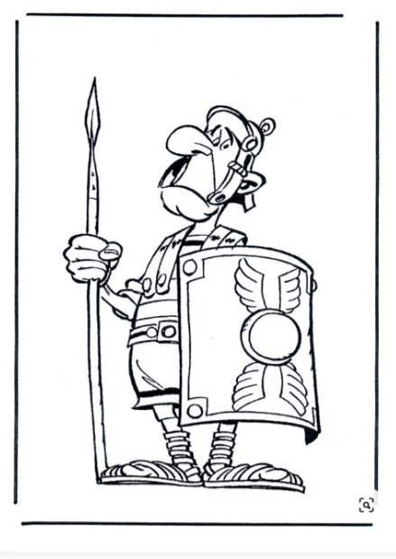



‘35
‘55
‘53

Slide 5




‘62
‘09
‘59
‘88

Slide 6


‘19
‘24
CP13
COMMON
PRACTICE
‘20

Slide 7
Takeaways ?

Slide 8
Bad faith has a dual meaning, with both absolute & relative elements.
It aims to:
- foster fair competition;
- in step with functionsTM.
Uniform framework for
assessing time, evidence, extent.

Slide 9
‘Relative inadmissibility’
‘Absolute inadmissibility’
Unfairly undermining third party interests
E.g. ‘filing with intention to prevent others continuing prior use” [Lindt]
CP13: ‘misappropriation’
Filing not in step with functionsTM
E.g. ‘filing without any intention to use and no rationale’ [Sky]
CP13: ‘abuse of system’

Slide 10
Latest development
CP13
Common
Practice

Slide 11
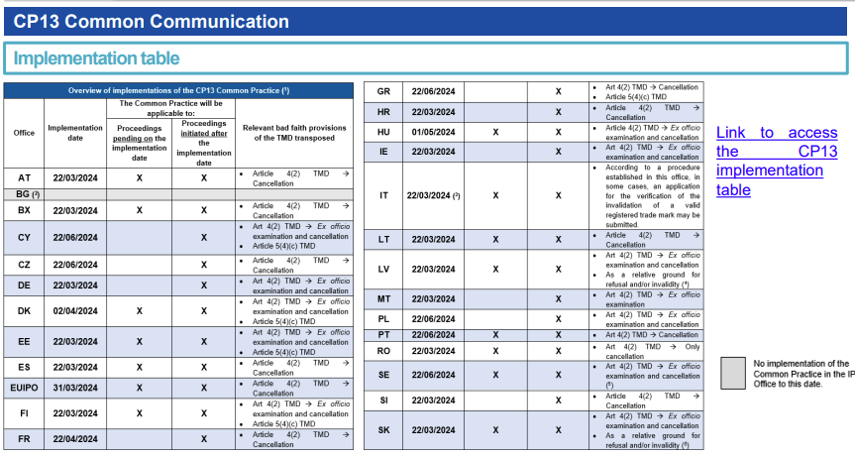

Slide 12
CP13: policy considerations
‘24
Strengths
Weaknesses
Robust analysis.
Dedicated learning materials for convergence.
Only half the story: only refers to CJEU and GC.
Does not include acquis in MS.
Opportunities
Threats
Any role for TLI ?
MS can follow lessons learned elsewhere, e.g. introduce bad faith as ground for refusal? (AI?)
Persuasive precedent of EUTM courts in MS declines.
Open norms are just that, open norms: anything goes ?

