Slide 1
Sustainable Reuses of Branded Goods: Infringement or Exhaustion?
Dirk Visser
Irene Calboli
Martin Senftleben
Chair: Charlotte Vrendenbarg
TLI Conference 15-16 September 2023, Erasmus University, Rotterdam

Slide 2
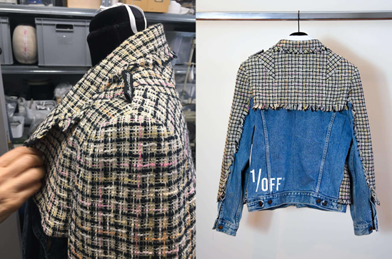
Upcycling & Trademark Law
Upcycling= the process of modifying original
branded products into new products for resale
Options:
Removal of the original trademark
Keep the original trademark using a disclaimer or label
Keep the original trademark without using a disclaimer or label
Impact of the exhaustion doctrine on upcycling
More effective trademark defences available?

Slide 3
Part II
Focus on Upcycling and the Doctrine of Exhaustion
Trademark law creates barriers to repair/refurbishment/upcycling
Legal uncertainty: chilling effect on product renewal and reuse activities
How to reduce these barriers?
Time to revisit traditional trademark doctrines?
Time to revisit certain assumptions on consumers’ perception?

