Slide 1

Comparative Advertising, Keyword Advertising and Other Modern Forms of Advertising
Trade Mark Law Institute Conference
Referential, Descriptive and Other Fair Use of Trademarks
1 December 2022
Dr. Anke Moerland
Anke.moerland@maastrichtuniversity.nl

Slide 2
Is there enough room for modern forms of advertising in EU trade mark law?
  Keyword advertising
  Comparative advertising
  Targeted advertising
  Is the use confusing? Is there sufficient transparency?
  Is unfair advantage being taken?
  How is the consumer defined?

Slide 3
Keyword advertising

Slide 4
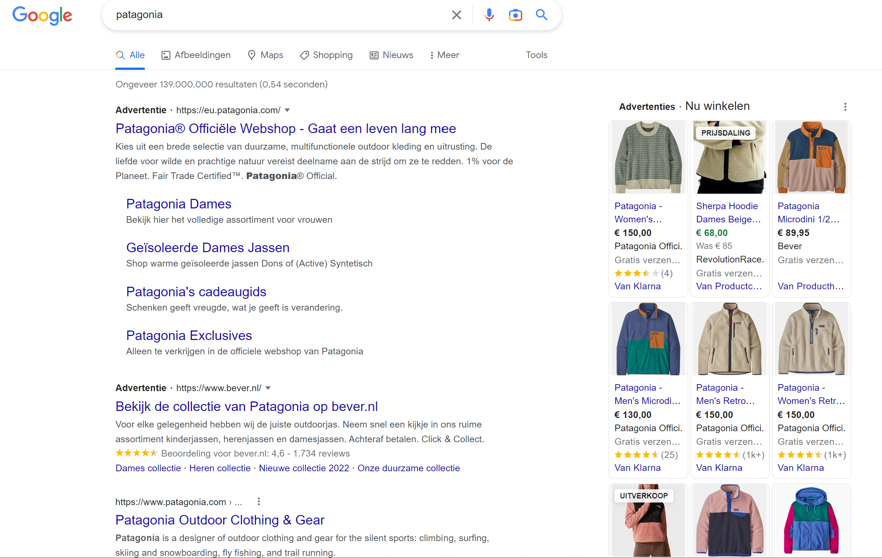

Slide 5
Is keyword advertising confusing?
Effect on origin function where the advertisement
  “while not suggesting the existence of an economic link, is vague to such an extent on the origin of the goods […] that normally informed and reasonably attentive internet user is unable to determine, on the basis of the advertising link and the commercial message” (Google France) whether there is an economic link
  Interflora:
    General knowledge of the market among relevant public
    Specific information in advertisement
    Number and size of retailers in commercial network
  Market transparency about whose products are sold
Notes:
Interflora:
Do internet users understand from advertisement that the service provided by M & S is independent from that of Interflora
on the basis of general knowledge of the market, that M & S’s flower-delivery service is not part of the Interflora network
commercial network of the trade mark proprietor is composed of a large number of retailers which vary greatly in terms of size and commercial profile. -particularly difficult to determine
= shift from proof of likely confusion by the trademark owner to an obligation on all advertisers to secure market transparency when using keyword advertising services

Slide 6
Is pre-sale confusion through keyword ads actionable?
Initial interest confusion
  = pre-sale confusion caused by an advertisement which could be dispelled before the consumer actually buys the advertised goods
Is there harm to trade mark owner in pre-sale confusion?
  No impact where briefly mistaken but quickly afterwards realizing mistake
  Advantage when clicking on advertisement, realizing mistake but choosing to make purchase with advertiser
  Loss of sale where realization of confusion before sale, but transaction already started that locks consumer into expectation to pay (Fhima 2013)
Actionable?
  CJEU O2 and BergSpechte: confusingly similar advertisements without need to show diversion of trade sufficient
Arguably: change in consumer’s economic behaviour necessary
Notes:
No impact: without any transacton
Expectation to pay:
sitting in taxi, starting ride before realizing not the right network;
having taken the exit for a petrol station that was not the one consumer wanted to choose

Slide 7
Is keyword advertising taking unfair advantage?
Purpose of using a trade mark with a reputation as keyword is to take advantage of the distinctive character and repute of the trade mark (Interflora)
  Large number of consumers sees competitor’s advertisement
  Some will purchase competitor’s product instead
  Rides on coat-tails; benefits from power of attraction, reputation and prestige
But: with due cause where fair competition in sector of goods
  offer of alternatives of goods and services
  that are no imitations
  no dilution or tarnishment
  no further affect on any of the trade mark functions
Notes:
Because of reputation of mark, a probably large number of consumers will see that competitor’s advertisement displayed on their screen
when internet users, having studied the competitor’s advertisement, purchase the product or service offered by the competitor instead of that of the proprietor of the trade mark to which their search originally related, that competitor derives a real advantage from the distinctive character and repute of the trade mark
As a general rule: does not pay financial compensation

Slide 8
Should free-riding be so easily allowed?
CJEU Interflora emphasizes that trade marks do not protect the proprietor against practices inherent in competition
  Intensifying advertising in order to enhance its profile
Aim:
  Offer internet users alternatives to the goods of trade mark proprietors (Interflora, para. 58; Google France, para. 69);
  Promote undistorted competition and possibilities of consumers to seek information about goods (AG Interflora para. 99)
But:
  Well-informed consumers making choices NOT at heart of unfair advantage – focus on legitimate and fair interests of businesses (Tritton)
  Through exclusivity (and not allowing free-riding), investment encouraged
Notes:
On advertising:
intensify its advertising in order to maintain or enhance its profile does not adversely affect the trade mark function
On investment function: No effect if the only consequence of that use is to oblige the proprietor of that trade mark to adapt its efforts to acquire or preserve a reputation capable of attracting consumers
AG Jääskinen
Aim:
- Allow internet users to choose from alternatives – Tritton: online version of comparative advertising

Slide 9
Comparative advertising

Slide 10
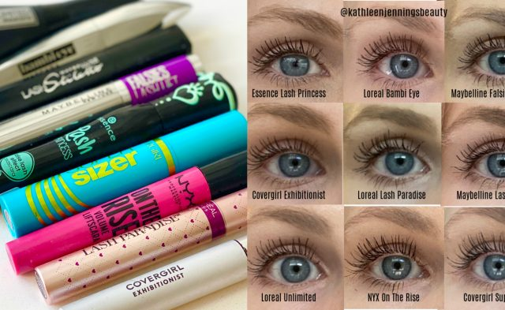
Notes:
Kathleen Jennings reviews and suggests mascara’s according to
Form
Volume
Length
Separation
Eye-lifting effect
Here: difference with keywords is that in the advertisement, an element of comparison is apparent, rather than just juxtaposing alternatives according to search results

Slide 11
Comparative Advertising Directive (CAD)
Cumulative CAD conditions
  Not misleading – consumer who is reasonably well-informed and circumspect
  Comparison as to the same needs/intended purpose
  Objective comparison of material, relevant, verifiable, representative feature
  Does not discredit or denigrate trade marks
  Where products have a designation of origin, comparison to products with same designation
  No confusion
  No unfair advantage
  No imitations or replica
Otherwise: infringing under Art. 9.3.f EUTMR/10.3 TMD, on double identity ground
Notes:
= demonstrating in an objective manner the advantages of various comparable goods
Stimulating competition between suppliers
No anticompetitive / unfair advertising that affects consumer interests adversely
Misleading: likely to deceive = likely to affect economic behaviour OR injure a competitor
Art. 6: factually correct information
Art. 7: omitting material information
Meeting same needs/intended purpose: sufficient degree of interchangeability for consumers (Lidl)
Objective: can include subjective criteria such as tase, smell
No discredit or denigrate: impersonal language that refers to particular characteristics
Not confusing: if confusing, not CAD compliant, therefore prohibited

Slide 12
Unfair advantage
Unfair advantage under CAD does not contain a “due cause” defence
  Ex. “Tastes like Nutella, but is produced under fair trade conditions”
  According to Google France, Interflora, competitor free-rides on trade mark’s reputation without contributing to promotional costs = takes unfair advantage
  Under CAD, no due cause defence where within ambit of fair competition
  Prohibited under CAD but not under EUTMR/TMD?
Notes:
Lawfulness comparative ad: exclusively governed by CAD
BUT according to O2 Holding: CAD conditions that have parallel provision in TMD/EUTMR are interpreted in the same manner (Recital 13 and 15 97/55 CAD Directive)
Potential Tony Chocolony chocolate pasta – correct statements, relevant features, objective language,
L’Oréal: comparison lists were not considered fair competition
Packaging and bottles of perfumes were also very similar to those of fragrances by L’Oreal
Smell-likes were considered imitations of an essential characteristic

Slide 13
No imitation or replica
= prohibits advertiser from stating that product constitutes an imitation or replica of the product covered by the trade mark (L’Oréal v Bellure, para. 75)
  Comparison lists suggest that perfumes are imitations of the fragrances marketed under certain marks
  Imitation of an essential characteristic (the smell of the goods) also qualifies as imitation
Fine line between products being imitations of essential characteristic and comparing objectively essential characteristics (imitating taste of Nutella?)
Notes:
Recital 19 97/55 CAD Directive: imitations and replica do not only include counterfeit products

Slide 14
Targeted advertising/ product recommendations
Notes:
Or computational advertising

Slide 15
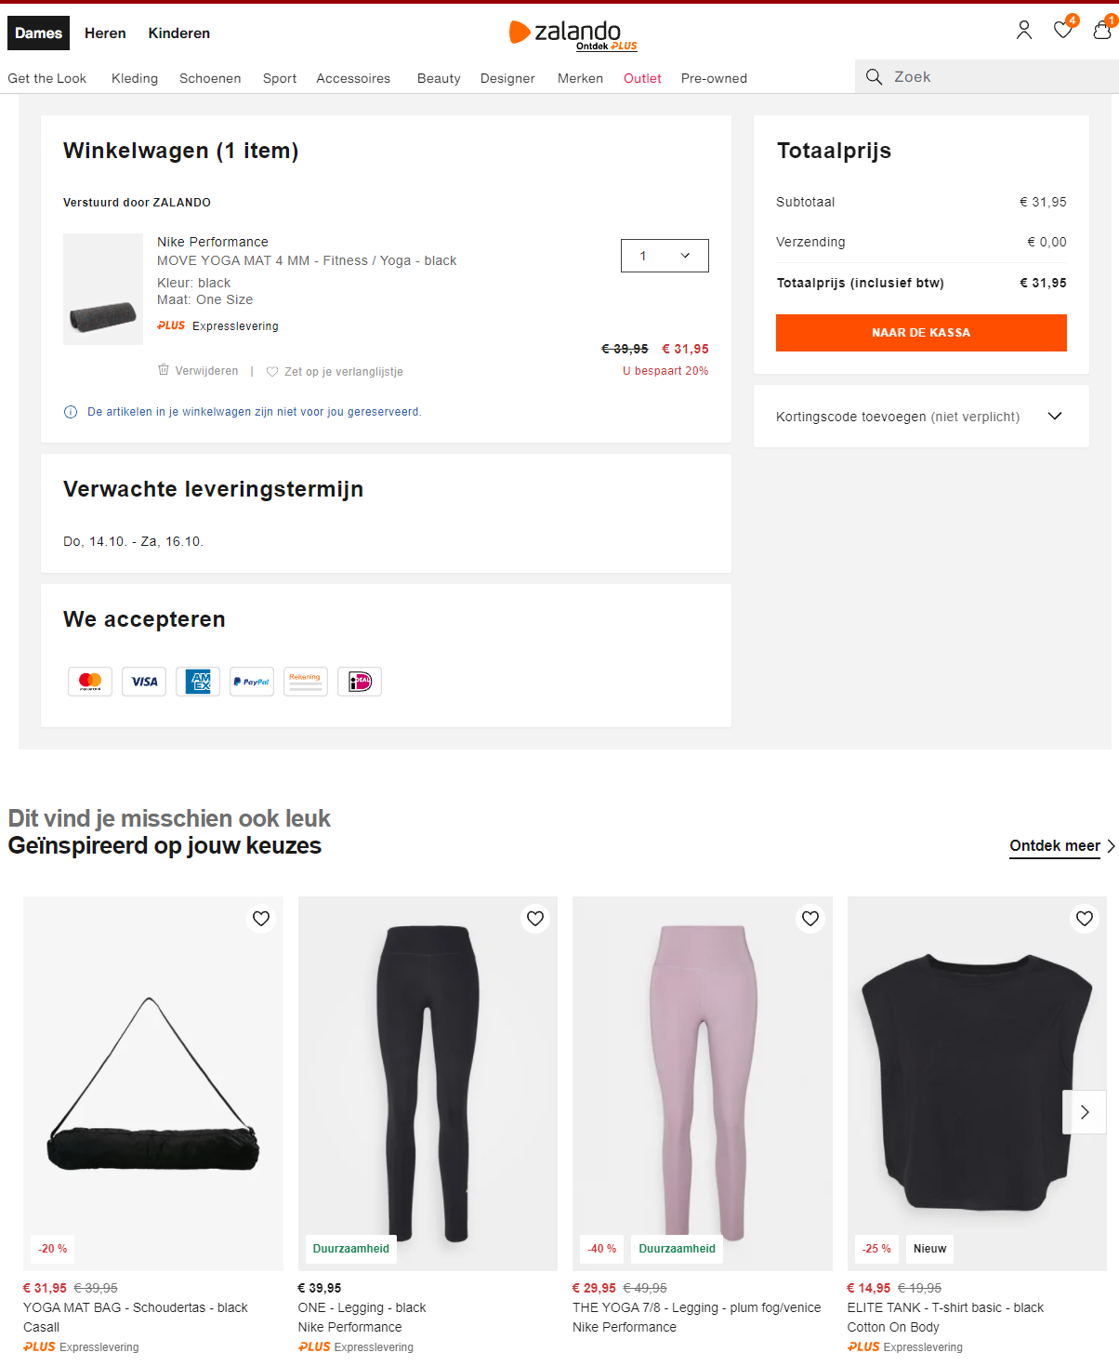
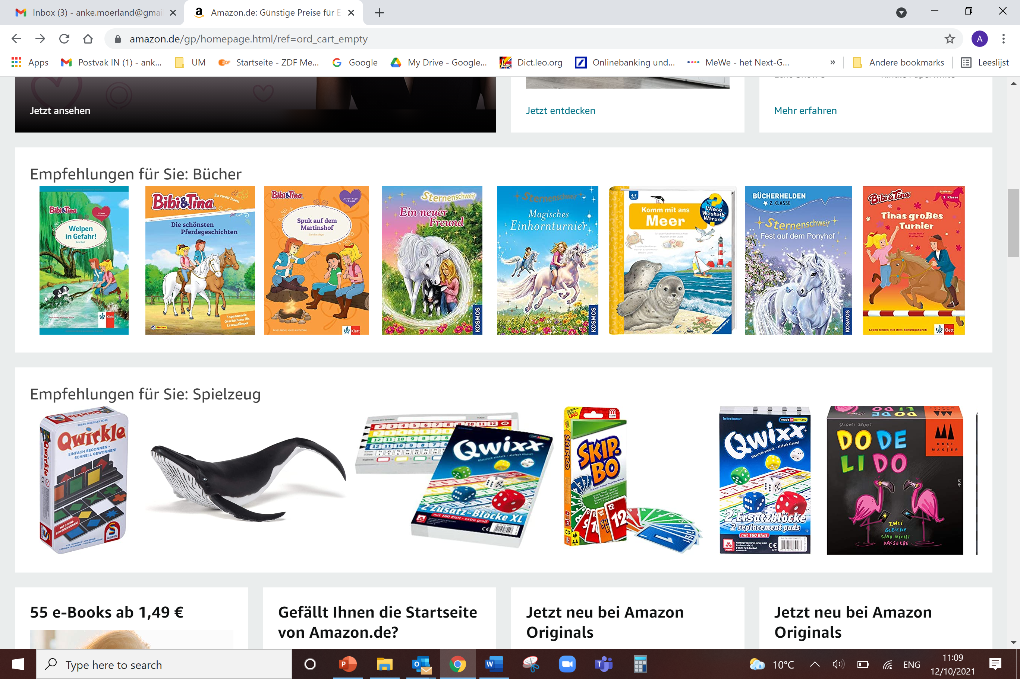


Notes:
‘recommendations based on your order’, ‘complete the look’, or ‘other customers have also viewed’,
content is similar to previous purchases of the same consumer
tracks what shoppers which products they repeatedly return to and what their mouse hovers over on the screen
Data from social media which posts I like or videos I share to know my values
Purchasing choices of consumers with similar profiles
Customer ratings of certain items
Similar to keyword advertising, but then not keyword but consumers own previous behaviour or other users with same profile generate advertisements

Slide 16
Is targeted advertising confusing?
  Confusion regarding how recommendations are generated, and what users are not seeing, RATHER THAN trade origin of products
  A matter of transparency in automated brand-related information
    Art. 24 DSA requires display of meaningful information about source and parameters that determine recipient of advertisements
    Recital 52 DSA also requires explanation of logic and whether based on profiling
  Confusion about commercial origin depends on advertisement
    Interflora/Google France conditions relevant
    Relevant where platforms sell both own and third party products (ex. Zalando)
  Savvy internet user in ever complex AI-driven environments?
Notes:
Transparency obligations mirror transparency concerns in keyword advertising
Art. 24 DSA
Online platforms displaying advertising on their online interfaces “shall ensure that the recipients of the service can identify, for each specific advertisement displayed to each individual recipient, in a clear and unambiguous manner and in real time:
(a) that the information displayed is an advertisement;
(b) the natural or legal person on whose behalf the advertisement is displayed;
(c) meaningful information about the main parameters used to determine the recipient to whom the advertisement is displayed.
very large online platforms (reaching more than 45 million monthly active recipients of the service), particular risks of targeting consumers based on their behaviour on the platform and outside: Art. 30(1) and (2), they must grant public access to repositories of all advertisements until 1 year after last use
Is it confusing where the product comes from, if consumers lack a clear understanding of data-driven targeting and persuasion tactics, and as a consequence do not realize that they are exposed to algorithmic marketing influences?

Slide 17
Questions

Slide 18
  Is pre-sale confusion actionable even without harm?
  Does aim of allowing consumers to choose among alternatives justify free-riding on trade marks reputation? Is exclusivity needed to stimulate investment in building reputation?
  In comparative advertising, is a due cause defence needed where unfair advantage is taken?
  What is exactly the difference between imitating and comparing essential characteristics?
  Do the transparency obligations in the DSA also lead to a lower likelihood of confusion as to commercial origin in targeted advertising?

Slide 19





Thank you for your attention!
anke.moerland@maastrichtuniversity.nl
www.maastrichtuniversity.nl/nl/anke.moerland
@AnkeMoerland
linkedin.com/in/anke-moerland

