Slide 1
EUTM’s in relation to earlier unregistered rights
9th TLI Symposium: EUTM‘s and the EU
Groningen, 22 March 2019

Slide 2
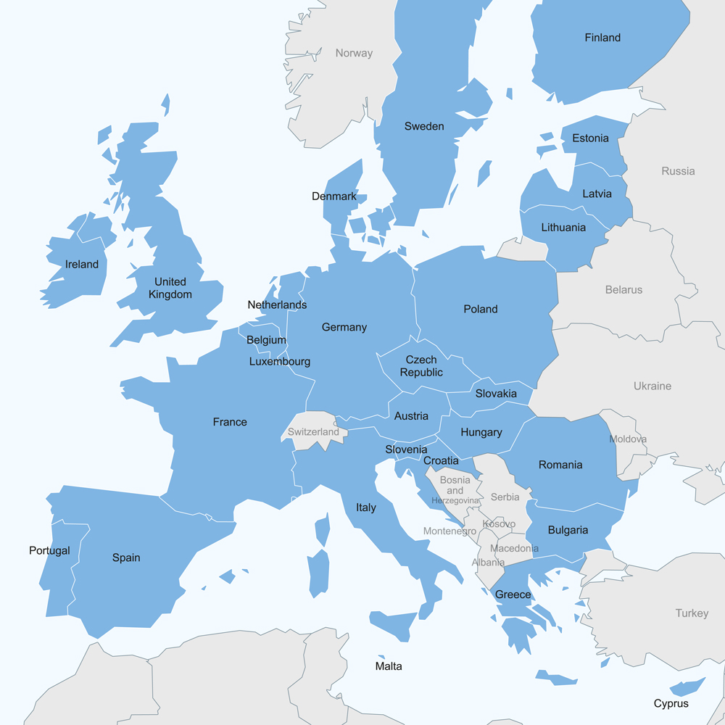
1. Introduction
Art 8: all-or-nothing approach for conflicts between EUTMs and earlier national
registered TMs (Art 8 (1))
unregistered TMs or another sign of more than mere local significance (Art 8 (4))
designations of origin or geographical indications (Art 8 (6))

Slide 3
1. Introduction
But right to prevent use of EU TMs only in one territory / locality
Art 137: earlier rights within the meaning of Art 8
Art 138: earlier rights of mere local significance in that locality
Subject to acquiescence
→ trade-off between rigid unitary character and proportionality

Slide 4
2. Elements of Art 8 (4)
Elements of Art 8 (4)
existence of a prior unregistered TM or other sign
of more than mere local significance
used in the course of trade
acquired prior to date of application / priority date
which confers right to prohibit the use of a subsequent TM

Slide 5
2. Elements of Art 8 (4)
Issue 1: what is “another sign“
Examples:
trade / corporate / establishment names
work titles (only if protected under national law as signs)
domain names?
Distinction from other rights which can only be involved in cancellation proceedings (Art 60 (2) EUTMR)
Personal names
© and design GC, T-255/08 – JOSE PADILLA

Slide 6
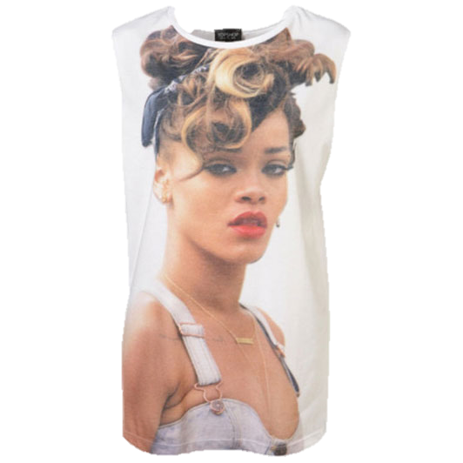
2. Elements of Art 8 (4)
Issue 1: what is „another sign“
Tort of passing off does not fit into these categories
Generally passing off qualifies under Art 8 (4): GC, T-304/09 – BASAmALI/BASMATI
But how about protection of personal names / pictures (such as Rihanna’s: Robyn Rihanna Fenty v Arcadia Group Brands, [2015] EWCA 3)?
Where to draw the line between a right in a and unfair competition actions preventing confusion? Example: product get-up
passing off (UK)
trade dress protection under Lanham Act (US)
§ 4 No 3 (a) Unfair Competition Act (Germany)

Slide 7
2. Elements of Art 8 (4)
Issue 2: more than mere local significance
EU law criterion
not merely a geographical test, but ”real presence“: account to be taken of duration and intensity (CJEU, C-96/09 P – Anheuser-Busch)
Separate assessment for each territory
Generally more than just one city (such as Vila Nova de Famalicão = 120,000 inhabitants: GC T-318/06 – GENERAL OPTICA)
Territory of one member state sufficient
Test relative to the territory of that member state?

Slide 8
2. Elements of Art 8 (4)
Issue 3: right to prohibit the use of the subsequent TM
According to national law
but see GC T-238/17 – GUGLER: EUIPO finding upheld that concept of LOC under French law of trade names and EU law identical
towards a Europeanisation of similar concepts?
What in cases of honest concurrent use under national law?

Slide 9
3. Perspectives
Alternative approaches to resolving the conflict between unity and territoriality
MPI TM study: unregistered rights which confer protection for the entire territory of a member state rather than “more than mere local significance”
Disregarding the borders between member states: significance for entire EU market?
Full co-existence = deletion of Art 8 (4)?
and retention of Arts 137, 138
or introduction of a new provision allowing co-existence while imposing a duty to avoid confusion?
Harmonisation of law of unregistered TMs and trade names

Slide 10
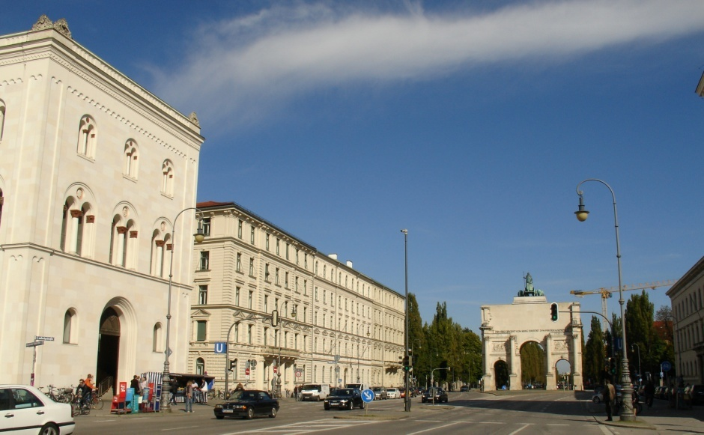
Thank you for your attention!

